Slide 1


Linear Algebra Query
Since linear algebra isn’t a formal pre-requisite for this class, I want to know how much (if any) linear algebra you know.
Question:
If $π_{1}=[0 0.5 0.5]$ and $P=\left[\begin{matrix}0 & 0.5 & 0.5 \\ 1 & 0 & 0 \\ 0.5 & 0.5 & 0\end{matrix}\right]$, what is $π_{2}=π_{1}P$?
https://joshh.ug/A

Slide 2
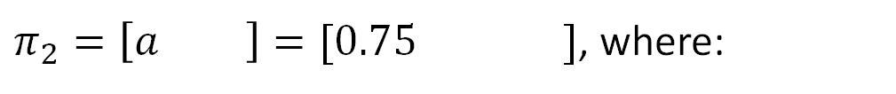

Linear Algebra Query
Since linear algebra isn’t a formal pre-requisite for this class, I want to know how much (if any) linear algebra you know.
Question:
If $π_{1}=[0 0.5 0.5]$ and $P=\left[\begin{matrix}0 & 0.5 & 0.5 \\ 1 & 0 & 0 \\ 0.5 & 0.5 & 0\end{matrix}\right]$, what is $π_{2}=π_{1}P$?
$π_{2}=\left[a b c\right]=[0.75 0.25 0]$, where:
$$a=0×0+0.5×1+0.5×0.5=0.75$$

Slide 3
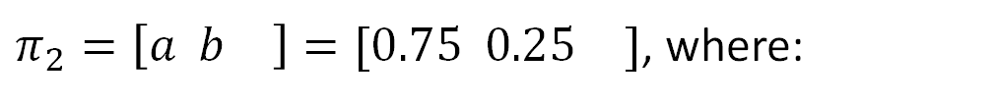

Linear Algebra Query
Since linear algebra isn’t a formal pre-requisite for this class, I want to know how much (if any) linear algebra you know.
Question:
If $π_{1}=[0 0.5 0.5]$ and $P=\left[\begin{matrix}0 & 0.5 & 0.5 \\ 1 & 0 & 0 \\ 0.5 & 0.5 & 0\end{matrix}\right]$, what is $π_{2}=π_{1}P$?
$π_{2}=\left[a b c\right]=[0.75 0.25 0]$, where:
$$a=0×0+0.5×1+0.5×0.5=0.75$$
$$b=0×0.5+0.5×0+0.5×0.5=0.25$$

Slide 4
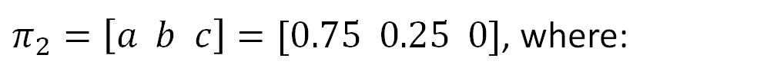

Linear Algebra Query
Since linear algebra isn’t a formal pre-requisite for this class, I want to know how much (if any) linear algebra you know.
Question:
If $π_{1}=[0 0.5 0.5]$ and $P=\left[\begin{matrix}0 & 0.5 & 0.5 \\ 1 & 0 & 0 \\ 0.5 & 0.5 & 0\end{matrix}\right]$, what is $π_{2}=π_{1}P$?
$π_{2}=\left[a b c\right]=[0.75 0.25 0]$, where:
$$a=0×0+0.5×1+0.5×0.5=0.75$$
$$b=0×0.5+0.5×0+0.5×0.5=0.25$$
$$c=0×0.5+0.5×0+0.5×0=0$$

Slide 5
Markov Chain Introduction
Markov Chain Introduction
Generating Samples from a Markov Chain
Hitting Time
Applications of Hitting Time
Probability of A Before B
The Invariant Distribution
Lecture 25, CS70 Fall 2025

Slide 6
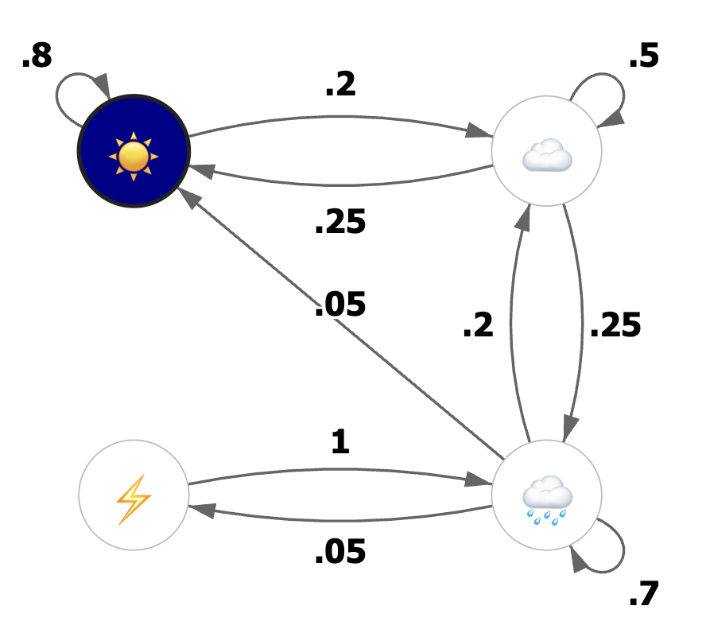
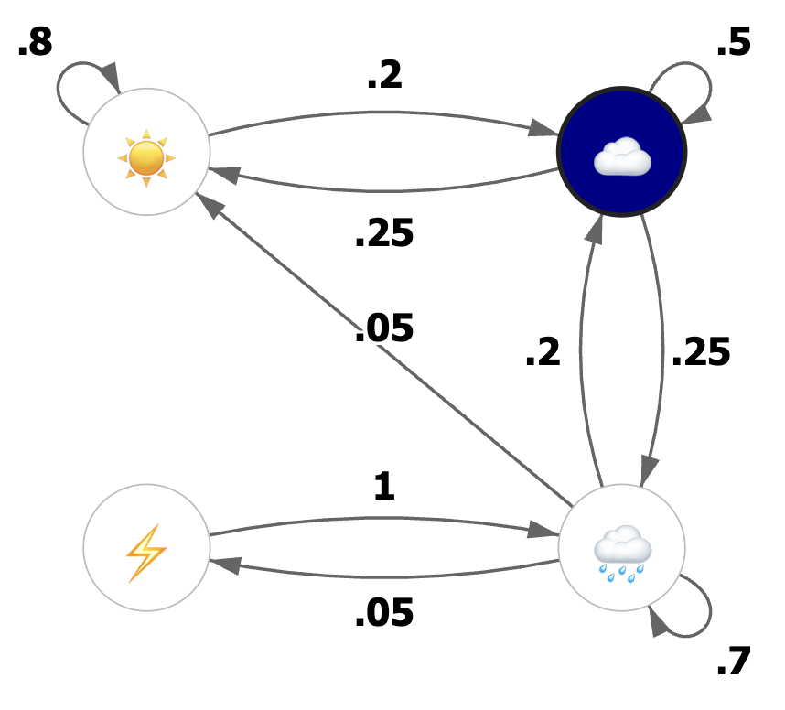
Weather Model
Suppose we have the very crude weather model below.
Example: If sunny now, 80% chance it will be sunny tomorrow.
Example: If cloudy today, 25% chance it will be rainy tomorrow.

Slide 7
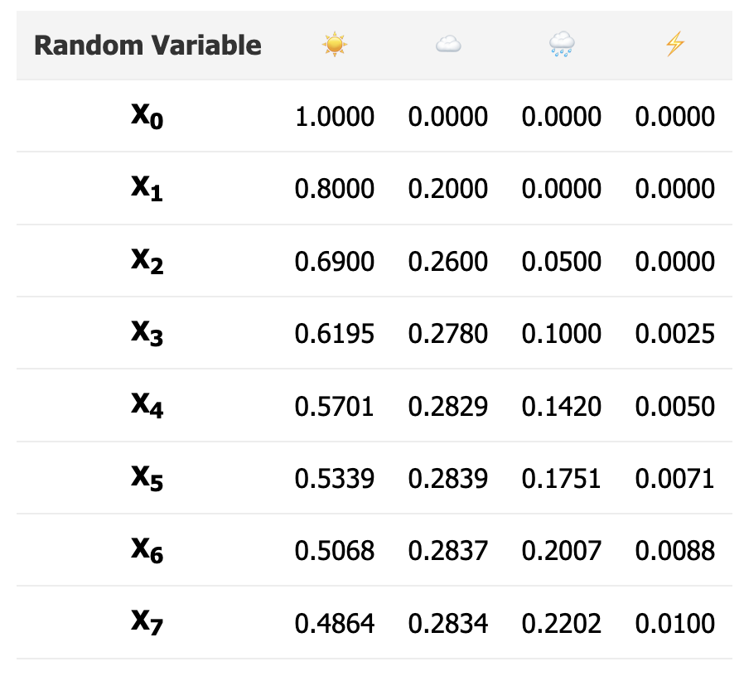
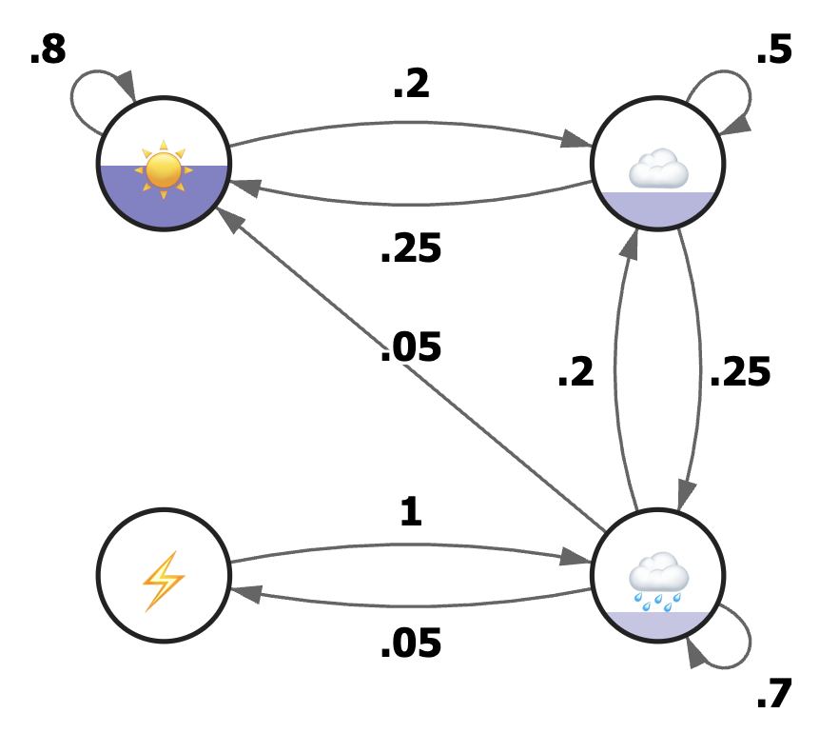
Simulating of Our Weather Model
Let’s run a simulation of this model: https://joshh.ug/cs70/markov_weather.html

Slide 8
Simulation Results
Results of our simulation are below.
On day 0, we knew it was sunny.
On day 1, 80% sunny, 20% cloudy.
…
On day 7, 48% sunny, 28% cloudy, 22% rainy, 1% stormy.

Slide 9
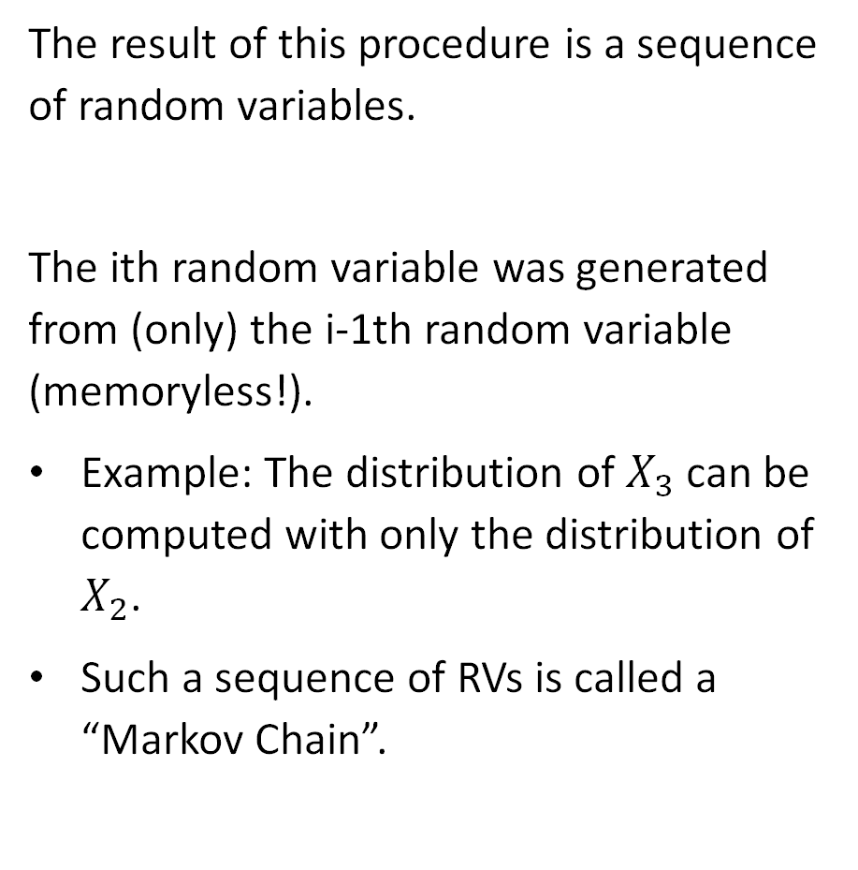
Random Process
The result of this procedure is a sequence of random variables.
The ith random variable was generated from (only) the i-1th random variable (memoryless!).
Example: The distribution of $X_{3}$ can be computed with only the distribution of $X_{2}$.
Such a sequence of RVs is called a “Markov Chain”.

Slide 10
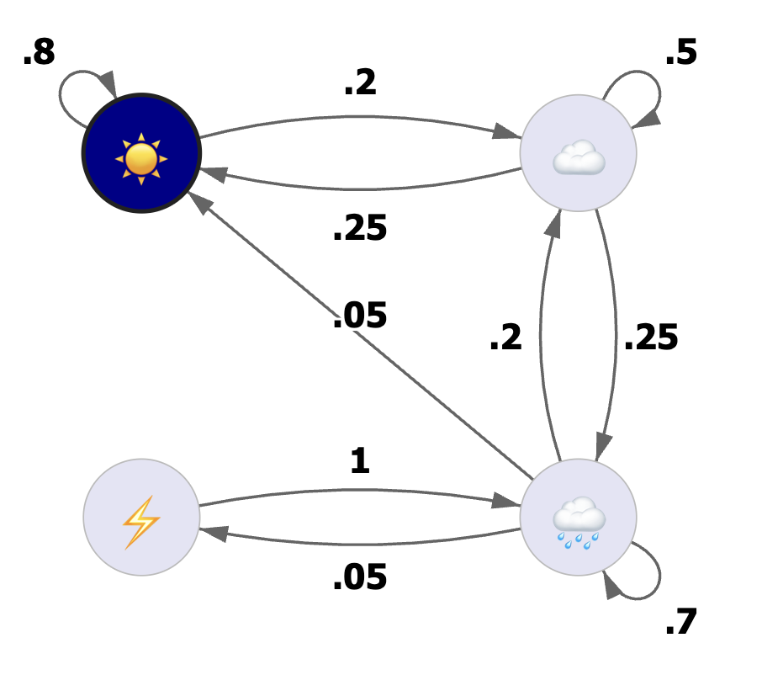

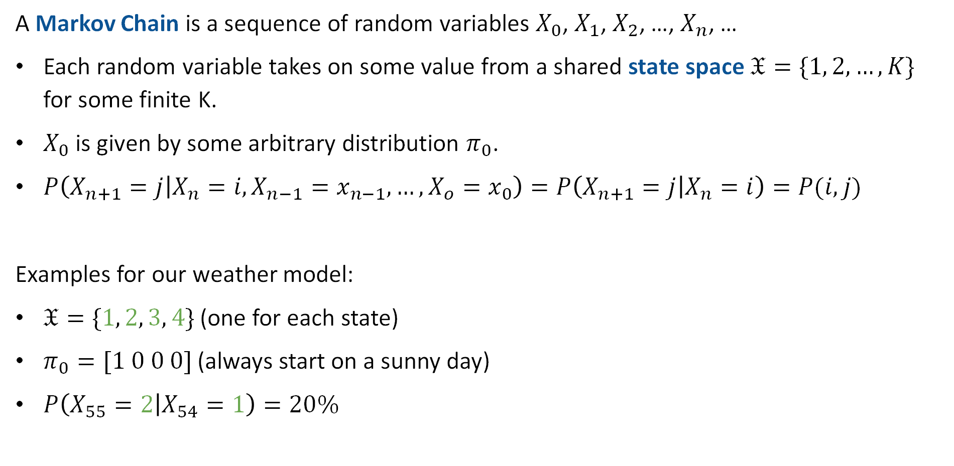



Markov Chain: Formal Definition
A Markov Chain is a sequence of random variables $X_{0}$, $X_{1}$, $X_{2}$, …, $X_{n}$, …
Each random variable takes on some value from a shared state space $𝔛=\{1, 2, …, K\}$ for some finite K.
$X_{0}$ is given by some arbitrary distribution $π_{0}$.
$P\left(X_{n+1}=j | X_{n}=i, X_{n−1}=x_{n−1},…,X_{o}=x_{0}\right)=P\left(X_{n+1}=j | X_{n}=i\right)=P(i,j)$
Examples for our weather model:
$𝔛=\{1, 2, 3, 4\}$ (one for each state)
$π_{0}=[1 0 0 0]$ (always start on a sunny day)
$P\left(X_{55}=2 | X_{54}=1\right)=20\%$
$$1$$
$$2$$
$$4$$
$$3$$

Slide 11


Markov Chain: Matrix Formulation
We can express the conditional probabilities of a Markov Chain using a matrix.
We call this the transition probability matrix.
For our weather model, this matrix is:
$$\left[\begin{matrix}0.8 & 0.2 & 0 & 0 \\ 0.25 & 0.5 & 0.25 & 0 \\ 0.05 & 0.2 & 0.7 & 0.05 \\ 0 & 0 & 1 & 0\end{matrix}\right]$$
$$1$$
$$2$$
$$P\left(X_{67}=4 | X_{66}=3\right)$$
$$4$$
$$3$$

Slide 12


Properties of the Transition Probability Matrix
The state space of a Markov Chain is $𝔛=\{1, 2, …, K\}$ for some finite K.
The transition probability matrix $P$ is a $K×K$ matrix such that:
$$P\left(i, j\right)≥0, ∀i,j∈𝔛$$
and the sum of each row is 1, i.e.
$$\sum_{j=1}^{K}{P\left(i, j\right)=1}, ∀i∈𝔛$$
$$\left[\begin{matrix}0.8 & 0.2 & 0 & 0 \\ 0.25 & 0.5 & 0.25 & 0 \\ 0.05 & 0.2 & 0.7 & 0.05 \\ 0 & 0 & 1 & 0\end{matrix}\right]$$

Slide 13
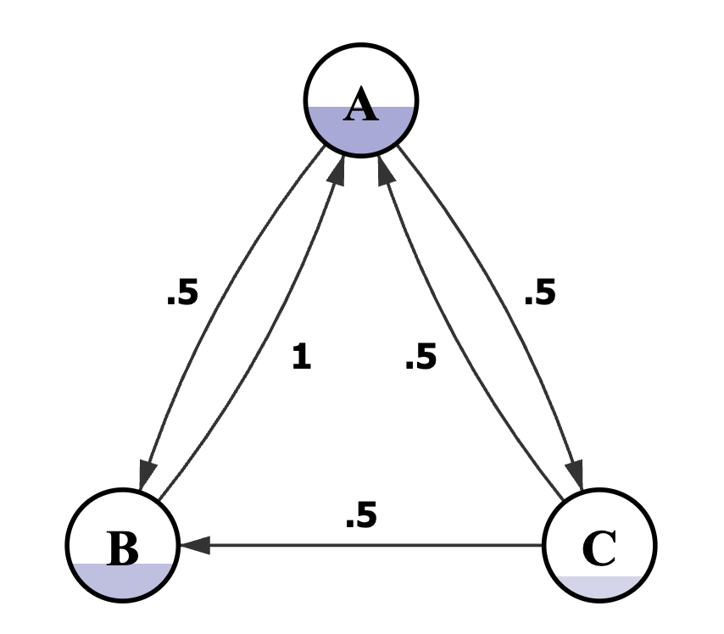
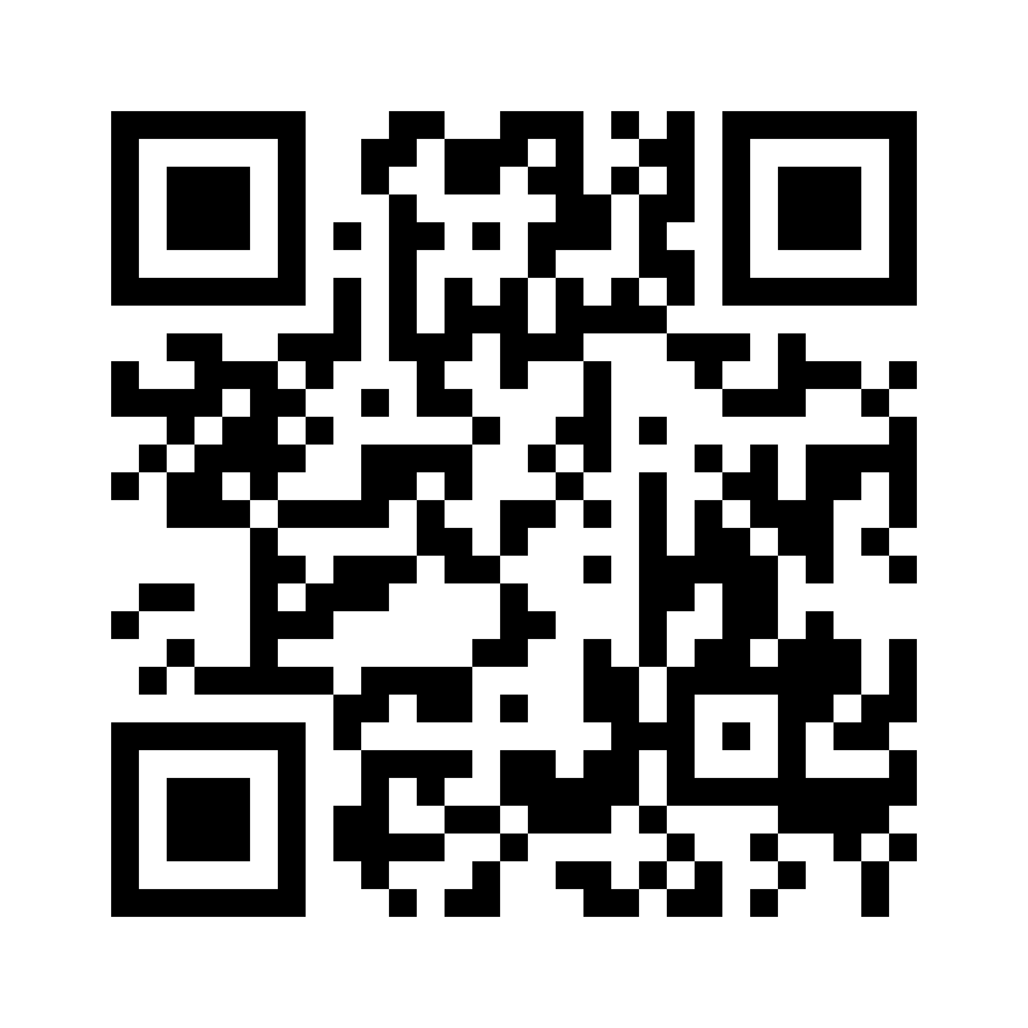
Test Your Understanding
What is the first row of the transition probability matrix for the Markov Chain below?
https://joshh.ug/B

Slide 14
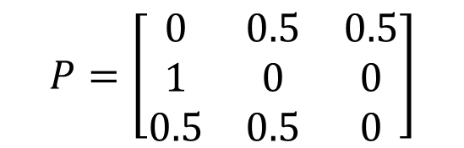
Test Your Understanding
What is the first row of the transition probability matrix for the Markov Chain below?
$$P=\left[\begin{matrix}0 & 0.5 & 0.5 \\ 1 & 0 & 0 \\ 0.5 & 0.5 & 0\end{matrix}\right]$$

Slide 15
Generating Samples from a Markov Chain
Markov Chain Introduction
Generating Samples from a Markov Chain
Hitting Time
Applications of Hitting Time
Probability of A Before B
The Invariant Distribution
Lecture 25, CS70 Fall 2025

Slide 16
Markov Chain Sample Generation Demo
How we’ve used a Markov Chain so far:
Given a definite state on day 0, what is the probability of all possible states at some later date?
An alternate usage: Generating samples.
Demo:
https://joshh.ug/cs70/markov_weather_sample_generator.html

Slide 17
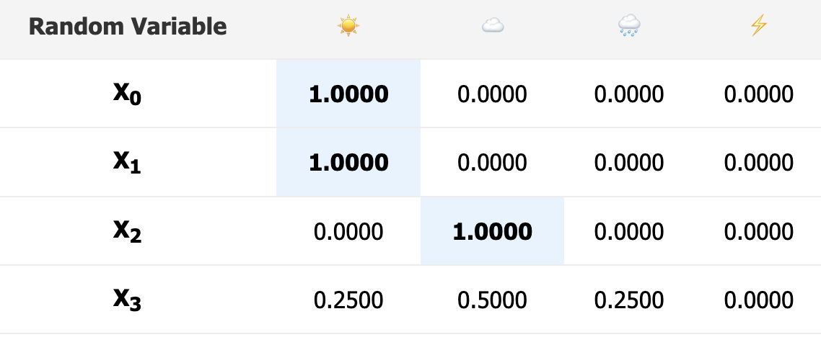
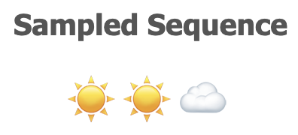

Markov Chain Sample Generation Demo
To generate samples we condition each sample on the output of the previously generated sample.
Example, the bottom row of table shown gives $P(X_{3}=x_{3}|X_{2}=\text{☁️}\text{)}$.

Slide 18
Hitting Time
Markov Chain Introduction
Generating Samples from a Markov Chain
Hitting Time
Applications of Hitting Time
Probability of A Before B
The Invariant Distribution
Lecture 25, CS70 Fall 2025

Slide 19

Hitting Time
Another question we might ask ourselves: If we start in state $i$, how any time steps $β\left(i\right)$ do we expect it to take before we hit end state $𝔈$?
For example if our desired end state is $𝔈=\text{☀️}$, we want to find $β\left(\text{☀️}\right)$, $β\left(\text{☁️}\right)$, $β\left(\text{🌧}\text{️}\right)$, and $β\left(\text{⚡}\right)$.

Slide 20


Hitting Time
Our desired end state is $𝔈=\text{☀️}$, we want to find $β\left(\text{☀️}\right)\text{, }β\left(\text{☁️}\right)\text{, }β\left(\text{🌧}\text{️}\right)\text{, }\text{and} β\left(\text{⚡}\right)$.
To do this, let’s write the so-called first step equations for this Markov Chain.
First, we’ll observe $β\left(\text{☀️}\right)=0$. This is trivial: If we’re at $\text{☀️}$ already, we have to wait 0 time steps to get to $\text{☀️}$.
$$β\left(\text{☀️}\right)=0$$

Slide 21


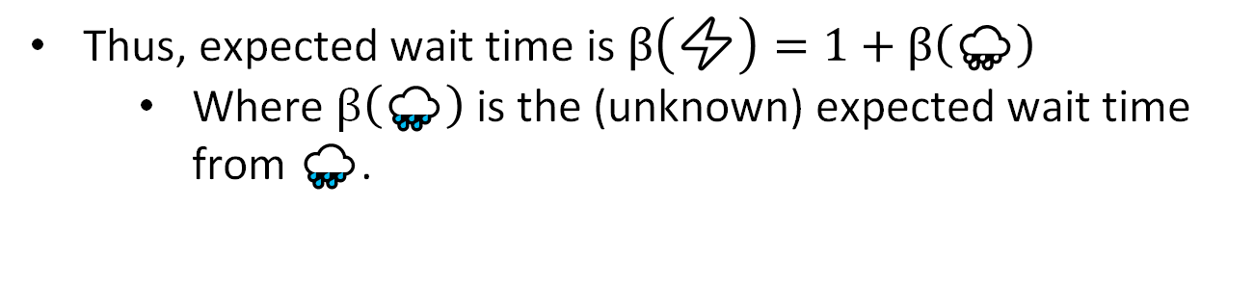
Hitting Time
Our desired end state is $𝔈=\text{☀️}$, we want to find $β\left(\text{☀️}\right)\text{, }β\left(\text{☁️}\right)\text{, }β\left(\text{🌧}\text{️}\right)\text{, }\text{and} β\left(\text{⚡}\right)$.
To do this, let’s write the so-called first step equations for this Markov Chain.
Next, let’s consider $β\left(\text{⚡}\right)$.
The only thing that can happen next is that we go to state $\text{🌧}\text{️}$.
Thus, expected wait time is $β\left(\text{⚡}\right)=1+β\left(\text{🌧}\text{️}\right)$
  Where $β\left(\text{🌧}\text{️}\right)$ is the (unknown) expected wait time from $\text{🌧}\text{️}$.
$$β\left(\text{☀️}\right)=0$$
$$β\left(\text{⚡}\right)=1+β\left(\text{🌧}\text{️}\right)$$

Slide 22
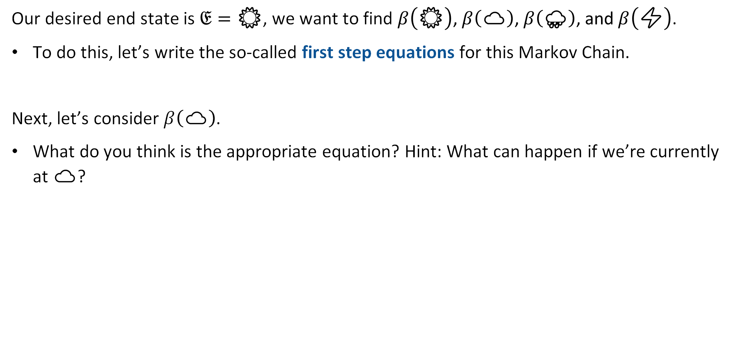
Hitting Time
Our desired end state is $𝔈=\text{☀️}$, we want to find $β\left(\text{☀️}\right)\text{, }β\left(\text{☁️}\right)\text{, }β\left(\text{🌧}\text{️}\right)\text{, }\text{and} β\left(\text{⚡}\right)$.
To do this, let’s write the so-called first step equations for this Markov Chain.
Next, let’s consider $β\left(\text{☁️}\right)$.
What do you think is the appropriate equation? Hint: What can happen if we’re currently at $\text{☁️}$?
$$β\left(\text{☀️}\right)=0$$
$$β\left(\text{⚡}\right)=1+β\left(\text{🌧}\text{️}\right)$$

Slide 23
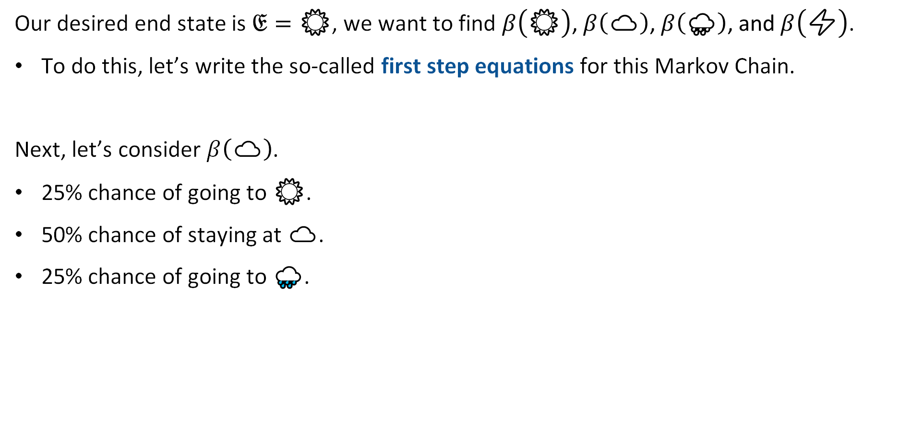
Hitting Time
Our desired end state is $𝔈=\text{☀️}$, we want to find $β\left(\text{☀️}\right)\text{, }β\left(\text{☁️}\right)\text{, }β\left(\text{🌧}\text{️}\right)\text{, }\text{and} β\left(\text{⚡}\right)$.
To do this, let’s write the so-called first step equations for this Markov Chain.
Next, let’s consider $β\left(\text{☁️}\right)$.
25% chance of going to $\text{☀️}$.
50% chance of staying at $\text{☁️}$.
25% chance of going to $\text{🌧}\text{️}$.
$$β\left(\text{☀️}\right)=0$$
$$β\left(\text{⚡}\right)=1+β\left(\text{🌧}\text{️}\right)$$

Slide 24
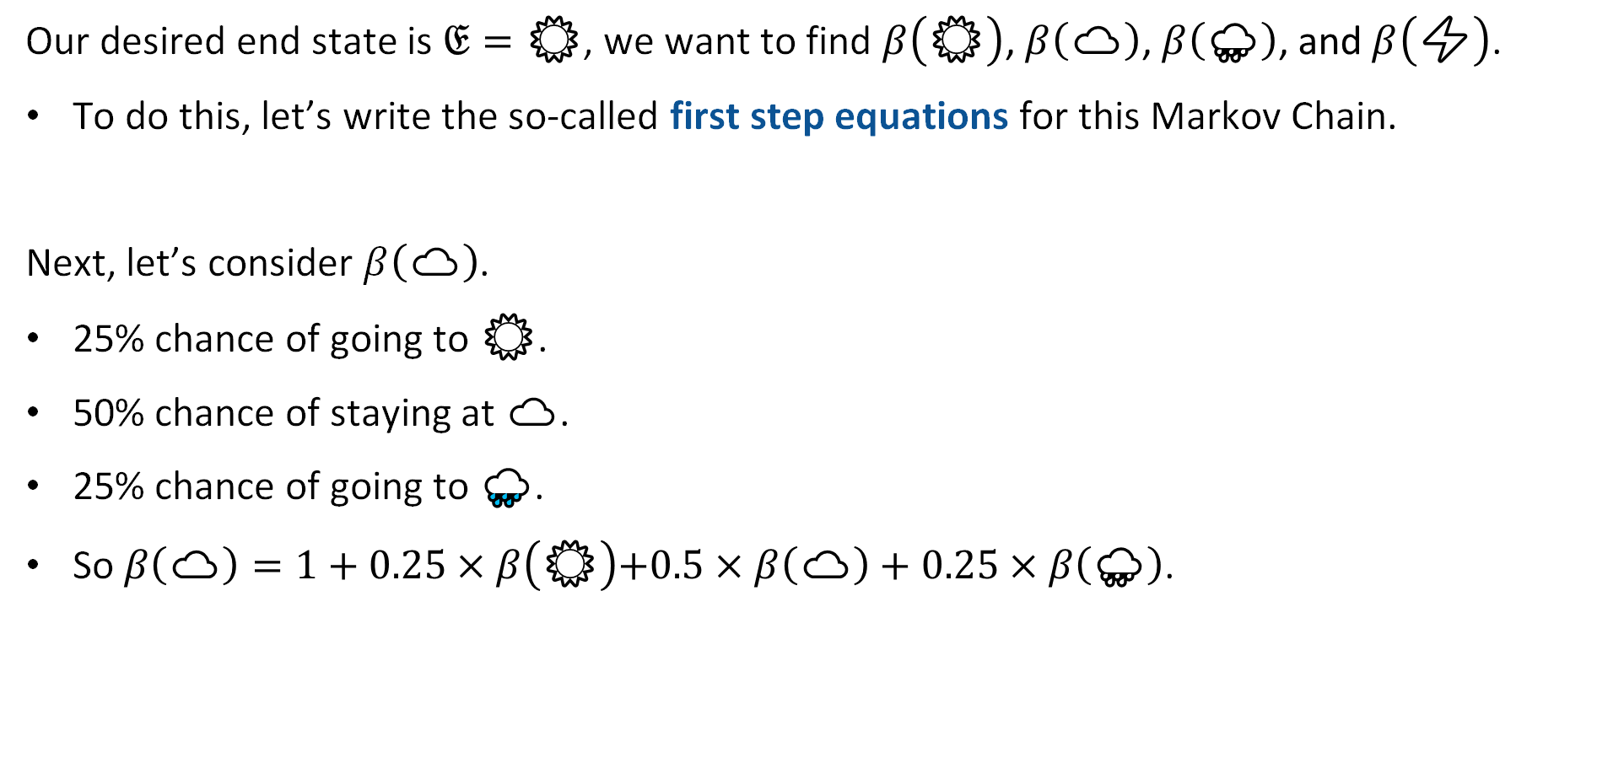
Hitting Time
Our desired end state is $𝔈=\text{☀️}$, we want to find $β\left(\text{☀️}\right)\text{, }β\left(\text{☁️}\right)\text{, }β\left(\text{🌧}\text{️}\right)\text{, }\text{and} β\left(\text{⚡}\right)$.
To do this, let’s write the so-called first step equations for this Markov Chain.
Next, let’s consider $β\left(\text{☁️}\right)$.
25% chance of going to $\text{☀️}$.
50% chance of staying at $\text{☁️}$.
25% chance of going to $\text{🌧}\text{️}$.
So $β\left(\text{☁️}\right)=1+0.25×β\left(\text{☀️}\right)\text{+0.5}×β\left(\text{☁️}\right)+0.25×β\left(\text{🌧}\text{️}\right)$.
$$β\left(\text{☀️}\right)=0$$
$$β\left(\text{☁️}\right)=1+0.25×β\left(\text{☀️}\right)\text{+0.5}×β\left(\text{☁️}\right)+0.25×β\left(\text{🌧}\text{️}\right)$$
$$β\left(\text{⚡}\right)=1+β\left(\text{🌧}\text{️}\right)$$

Slide 25
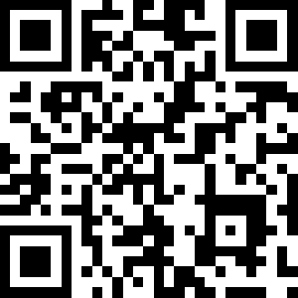

Hitting Time
Our desired end state is $𝔈=\text{☀️}$, we want to find $β\left(\text{☀️}\right)\text{, }β\left(\text{☁️}\right)\text{, }β\left(\text{🌧}\text{️}\right)\text{, }\text{and} β\left(\text{⚡}\right)$.
To do this, let’s write the so-called first step equations for this Markov Chain.
Lastly, let’s consider $β\left(\text{🌧}\text{️}\right)$.
What is it? https://joshh.ug/E
$$β\left(\text{☀️}\right)=0$$
$$β\left(\text{☁️}\right)=1+0.25×β\left(\text{☀️}\right)\text{+0.5}×β\left(\text{☁️}\right)+0.25×β\left(\text{🌧}\text{️}\right)$$
$$β\left(\text{⚡}\right)=1+β\left(\text{🌧}\text{️}\right)$$

Slide 26

Hitting Time
Our desired end state is $𝔈=\text{☀️}$, we want to find $β\left(\text{☀️}\right)\text{, }β\left(\text{☁️}\right)\text{, }β\left(\text{🌧}\text{️}\right)\text{, }\text{and} β\left(\text{⚡}\right)$.
To do this, let’s write the so-called first step equations for this Markov Chain.
Lastly, let’s consider $β\left(\text{🌧}\text{️}\right)$.
$1+0.05×β\left(\text{☀️}\right)+0.2×β\left(\text{☁️}\right)+0.7×β\left(\text{🌧}\text{️}\right)+0.05×β\left(\text{⚡}\right)$
$$β\left(\text{☀️}\right)=0$$
$$β\left(\text{☁️}\right)=1+0.25×β\left(\text{☀️}\right)\text{+0.5}×β\left(\text{☁️}\right)+0.25×β\left(\text{🌧}\text{️}\right)$$
$$β\left(\text{⚡}\right)=1+β\left(\text{🌧}\text{️}\right)$$

Slide 27
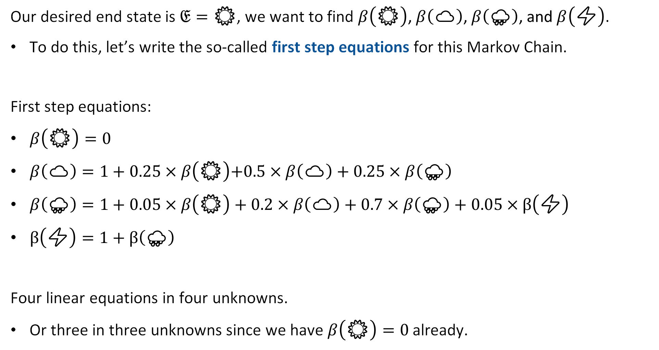
Hitting Time
Our desired end state is $𝔈=\text{☀️}$, we want to find $β\left(\text{☀️}\right)\text{, }β\left(\text{☁️}\right)\text{, }β\left(\text{🌧}\text{️}\right)\text{, }\text{and} β\left(\text{⚡}\right)$.
To do this, let’s write the so-called first step equations for this Markov Chain.
First step equations:
$β\left(\text{☀️}\right)=0$
$β\left(\text{☁️}\right)=1+0.25×β\left(\text{☀️}\right)\text{+0.5}×β\left(\text{☁️}\right)+0.25×β\left(\text{🌧}\text{️}\right)$
$β\left(\text{🌧}\text{️}\right)=1+0.05×β\left(\text{☀️}\right)+0.2×β\left(\text{☁️}\right)+0.7×β\left(\text{🌧}\text{️}\right)+0.05×β\left(\text{⚡}\right)$
$β\left(\text{⚡}\right)=1+β\left(\text{🌧}\text{️}\right)$
Four linear equations in four unknowns.
Or three in three unknowns since we have $β\left(\text{☀️}\right)=0$ already.

Slide 28

Hitting Time
Answer is given by the system of linear equations:
$β\left(\text{☀️}\right)=0$
$β\left(\text{☁️}\right)=1+0.25×β\left(\text{☀️}\right)\text{+0.5}×β\left(\text{☁️}\right)+0.25×β\left(\text{🌧}\text{️}\right)$
$β\left(\text{🌧}\text{️}\right)=1+0.05×β\left(\text{☀️}\right)+0.2×β\left(\text{☁️}\right)+0.7×β\left(\text{🌧}\text{️}\right)+0.05×β\left(\text{⚡}\right)$
$β\left(\text{⚡}\right)=1+β\left(\text{🌧}\text{️}\right)$
Straightforward to solve (through substitution, gaussian elimination, computer solver, etc).
If you want to see all the work click here.

Slide 29
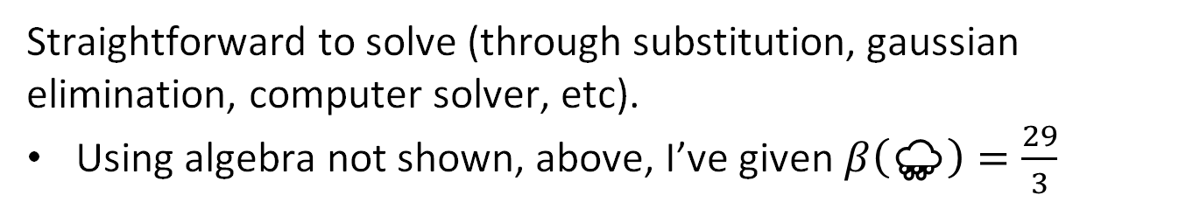

Hitting Time
Answer is given by the system of linear equations:
$β\left(\text{☀️}\right)=0$
$β\left(\text{☁️}\right)=1+0.25×β\left(\text{☀️}\right)\text{+0.5}×β\left(\text{☁️}\right)+0.25×β\left(\text{🌧}\text{️}\right)$
$β\left(\text{🌧}\text{️}\right)=\frac{29}{3}≈9.67$
$β\left(\text{⚡}\right)=1+β\left(\text{🌧}\text{️}\right)$
Straightforward to solve (through substitution, gaussian elimination, computer solver, etc).
Using algebra not shown, above, I’ve given $β\left(\text{🌧}\text{️}\right)=\frac{29}{3}$

Slide 30

Hitting Time
Answer is given by the system of linear equations:
$β\left(\text{☀️}\right)=0$
$β\left(\text{☁️}\right)=1+0.25×β\left(\text{☀️}\right)\text{+0.5}×β\left(\text{☁️}\right)+0.25×β\left(\text{🌧}\text{️}\right)$
$β\left(\text{🌧}\text{️}\right)=\frac{29}{3}≈9.67$
$β\left(\text{⚡}\right)=\frac{32}{3}≈10.67$
Straightforward to solve (through substitution, gaussian elimination, computer solver, etc).

Slide 31

Hitting Time
Answer is given by the system of linear equations:
$β\left(\text{☀️}\right)=0$
$β\left(\text{☁️}\right)=\text{1}\text{+0.5}×β\left(\text{☁️}\right)+\frac{29}{12}$
$β\left(\text{🌧}\text{️}\right)=\frac{29}{3}≈9.67$
$β\left(\text{⚡}\right)=\frac{32}{3}≈10.67$
Straightforward to solve (through substitution, gaussian elimination, computer solver, etc).

Slide 32

Hitting Time
Answer is given by the system of linear equations:
$β\left(\text{☀️}\right)=0$
$0.5×β\left(\text{☁️}\right)=\frac{41}{12}$
$β\left(\text{🌧}\text{️}\right)=\frac{29}{3}≈9.67$
$β\left(\text{⚡}\right)=\frac{32}{3}≈10.67$
Straightforward to solve (through substitution, gaussian elimination, computer solver, etc).

Slide 33

Hitting Time
Answer is given by the system of linear equations:
$β\left(\text{☀️}\right)=0$
$β\left(\text{☁️}\right)=\frac{41}{6}≈6.83$
$β\left(\text{🌧}\text{️}\right)=\frac{29}{3}≈9.67$
$β\left(\text{⚡}\right)=\frac{32}{3}≈10.67$
Interpretation: If it is currently rainy, then it’ll be 9.67 days on average before it is sunny again.

Slide 34

Hitting Time
Hitting time, naturally, depends on our desired state.
Example: If we want the number of steps before it is stormy, i.e. $𝔈=\text{⚡}$ then we’ll have instead that (link):
  $β\left(\text{⚡}\right)=0$
  $β\left(\text{🌧}\text{️}\right)=79$
  $β\left(\text{☁️}\right)=70$
  $β\left(\text{☀️}\right)=84$
The low probability of transition to stormy weather is reflected in the long hitting times from the other three starting states.

Slide 35
Applications of Hitting Time
Markov Chain Introduction
Generating Samples from a Markov Chain
Hitting Time
Applications of Hitting Time
Probability of A Before B
The Invariant Distribution
Lecture 25, CS70 Fall 2025

Slide 36
Application of Hitting Time
Before, we saw how we could apply hitting time analysis to understand how long we have to wait on average for a state in a Markov Model.
We can also frame problems we’ve seen before as Markov Model hitting time problems.
Example: Computing the expectation of a geometric random variable.
New powerful tool that makes our lives easier!

Slide 37
Example: Expectation of a Geometric Random Variable
How can we cast the expectation of a geometric random variable in terms of hitting time?
What are the states of our Markov Model?
What are the probabilities?
What hitting time should we compute?

Slide 38
Example: Expectation of a Geometric Random Variable
How can we cast the expectation of a geometric random variable in terms of hitting time?
What are the states of our Markov Model?
What are the probabilities?
What hitting time should we compute?
The expectation of a geometric random variable is the expected number of flips before we get heads.

Slide 39
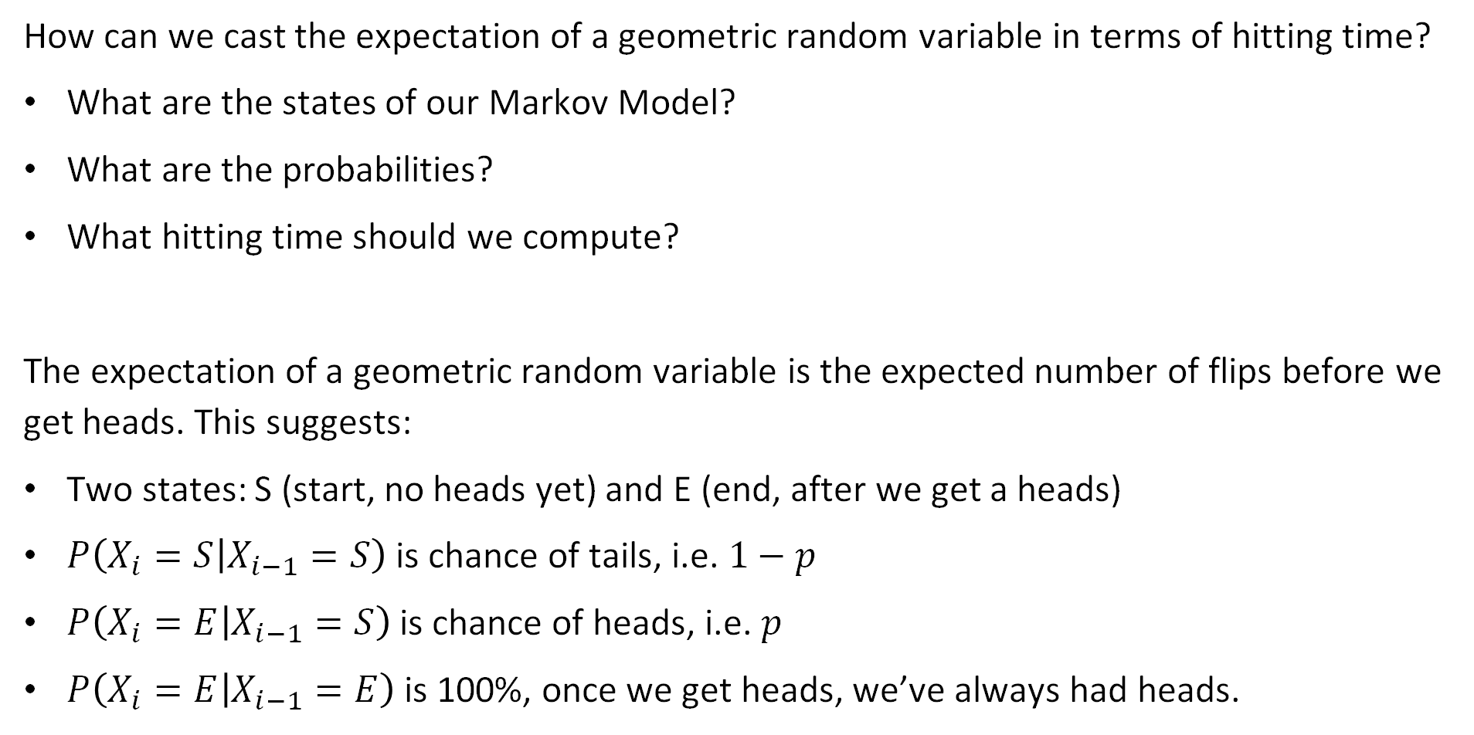
Example: Expectation of a Geometric Random Variable
How can we cast the expectation of a geometric random variable in terms of hitting time?
What are the states of our Markov Model?
What are the probabilities?
What hitting time should we compute?
The expectation of a geometric random variable is the expected number of flips before we get heads. This suggests:
Two states: S (start, no heads yet) and E (end, after we get a heads)
$P\left(X_{i}=S | X_{i−1}=S\right)$ is chance of tails, i.e. $1−p$
$P\left(X_{i}=E | X_{i−1}=S\right)$ is chance of heads, i.e. $p$
$P\left(X_{i}=E | X_{i−1}=E\right)$ is 100%, once we get heads, we’ve always had heads.

Slide 40
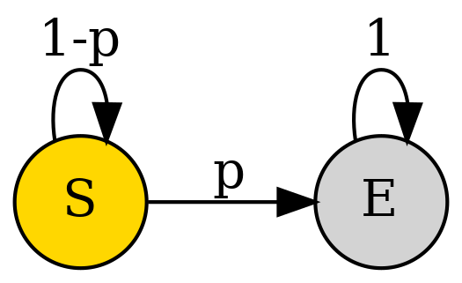
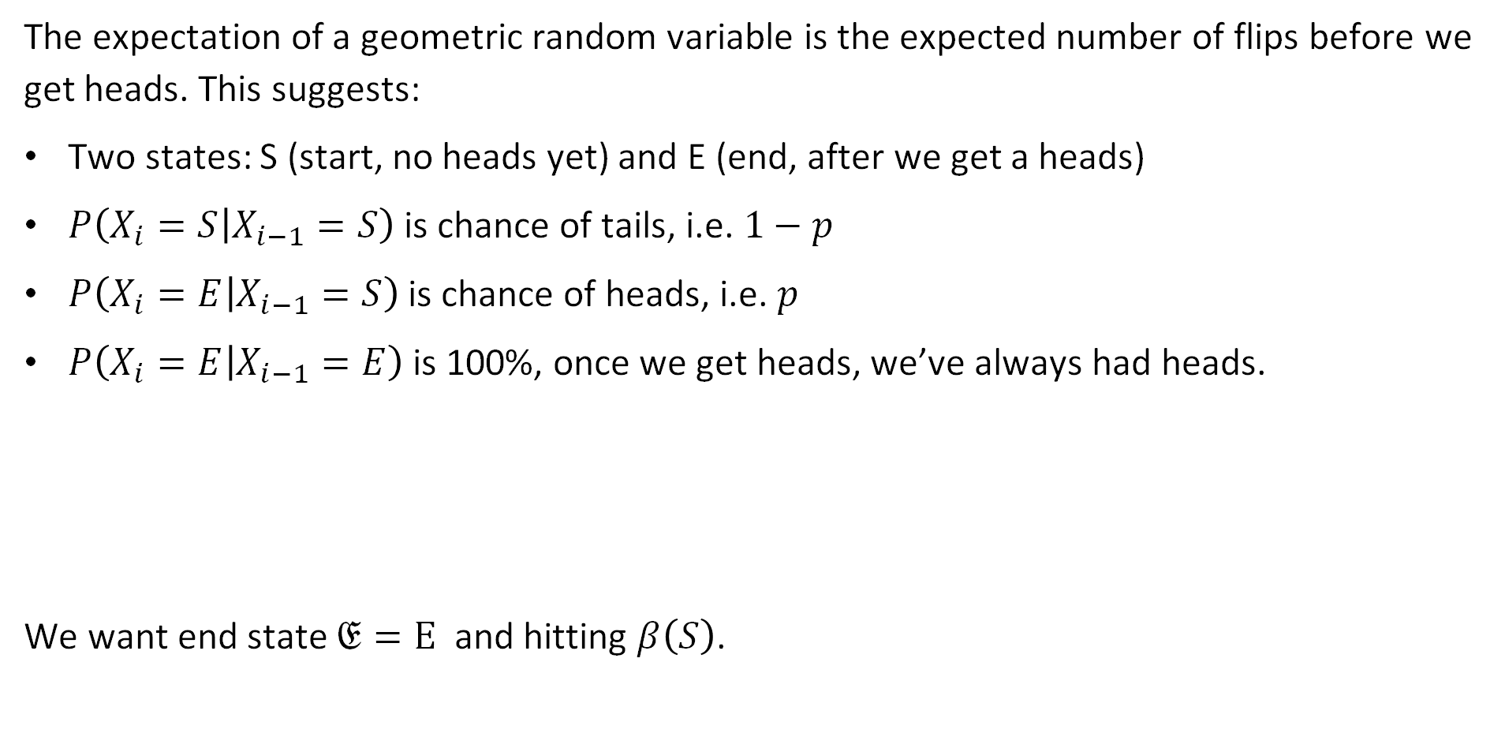
Example: Expectation of a Geometric Random Variable
The expectation of a geometric random variable is the expected number of flips before we get heads. This suggests:
Two states: S (start, no heads yet) and E (end, after we get a heads)
$P\left(X_{i}=S | X_{i−1}=S\right)$ is chance of tails, i.e. $1−p$
$P\left(X_{i}=E | X_{i−1}=S\right)$ is chance of heads, i.e. $p$
$P\left(X_{i}=E | X_{i−1}=E\right)$ is 100%, once we get heads, we’ve always had heads.
We want end state $𝔈=\text{E}$ and hitting $β\left(S\right)$.

Slide 41

Example: Expectation of a Geometric Random Variable
We want end state $𝔈=\text{E}$ and hitting $β\left(S\right)$.
First step equations:
$β\left(S\right)=1+\left(1−p\right)β\left(S\right)+pβ\left(E\right)$
$β\left(E\right)=0$
Easy to solve.

Slide 42

Example: Expectation of a Geometric Random Variable
We want end state $𝔈=\text{E}$ and hitting $β\left(S\right)$.
First step equations:
$β\left(S\right)=1+β\left(S\right)−pβ\left(S\right)$
$β\left(E\right)=0$
Easy to solve.

Slide 43

Example: Expectation of a Geometric Random Variable
We want end state $𝔈=\text{E}$ and hitting $β\left(S\right)$.
First step equations:
$0=1−pβ\left(S\right)$
$β\left(E\right)=0$
Easy to solve.

Slide 44

Example: Expectation of a Geometric Random Variable
We want end state $𝔈=\text{E}$ and hitting $β\left(S\right)$.
First step equations:
$pβ\left(S\right)=1$
$β\left(E\right)=0$
Easy to solve.

Slide 45

Example: Expectation of a Geometric Random Variable
We want end state $𝔈=\text{E}$ and hitting $β\left(S\right)$.
First step equations:
$β\left(S\right)=1/p$
$β\left(E\right)=0$
Easy to solve.
Much simpler than our two previous approaches.

Slide 46

Example 2: Flipping Until Two Consecutive Heads.
Suppose we now want to model the process of flipping a coin until we get two consecutive heads.
What does the equivalent Markov Chain look like?
How many flips on average do you think it will take if coin is fair, i.e. $p=0.5$?

Slide 47


Example 2: Flipping Until Two Consecutive Heads.
Suppose we now want to model the process of flipping a coin until we get two consecutive heads. What does the equivalent Markov Chain look like?
First step equations:
$β\left(S\right)=1+\left(1−p\right)β\left(S\right)+pβ\left(H\right)$
$β\left(H\right)=1+\left(1−p\right)β\left(S\right)+pβ\left(E\right)$
$β\left(E\right)=0$

Slide 48





Example 2: Flipping Until Two Consecutive Heads.
Suppose we now want to model the process of flipping a coin until we get two consecutive heads. What does the equivalent Markov Chain look like?
First step equations:
$β\left(S\right)=1+\left(1−p\right)β\left(S\right)+pβ\left(H\right)$
$β\left(H\right)=1+\left(1−p\right)β\left(S\right)$
$=1+\left(1−p\right)β\left(S\right)+p(1+\left(1−p\right)β\left(S\right)$)
$$β\left(S\right)=1+β\left(S\right)−pβ\left(S\right)+p+pβ\left(S\right)−p^{2}β\left(S\right)$$
$$p^{2}β\left(S\right)=1+p$$
$$β\left(S\right)=\frac{3/2}{1/4}=6$$
$$β\left(S\right)=\frac{1+p}{p^{2}}$$
If $p=0.5$:

Slide 49
Probability of A Before B
Markov Chain Introduction
Generating Samples from a Markov Chain
Hitting Time
Applications of Hitting Time
Probability of A Before B
The Invariant Distribution
Lecture 25, CS70 Fall 2025

Slide 50


Probability of A Before B
Another problem we might ask about Markov Chains: What is the probability that if we start at state $i$, that we reach state $A$ before state $B$?
Example: You’re gambling, have a 50/50 chance of winning. Every round:
50% chance you win $1.
50% chance you lose $1.
Your plan is to keep playing until you make $100.
If you start with $10 dollars, what’s the chance you get to $100 before you get to $0?

Slide 51

Probability of A Before B
Another problem we might ask about Markov Chains: What is the probability that if we start at state $i$, that we reach state $A=100$ before state $B=0$?
For $i∈\left\{0, 1, …, 100\right\}$. Let $α\left(i\right)$ be the probability of reaching 100 before 0 starting at $i$. Which of these are true?
$α\left(0\right)=0$
$α\left(0\right)=1$
$α\left(100\right)=0$
$α\left(100\right)=1$

Slide 52

Probability of A Before B
Another problem we might ask about Markov Chains: What is the probability that if we start at state $i$, that we reach state $A=100$ before state $B=0$?
For $i∈\left\{0, 1, …, 100\right\}$. Let $α\left(i\right)$ be the probability of reaching 100 before 0 starting at $i$. Which of these are true?
$α\left(0\right)=1$
$α\left(0\right)=0$
$α\left(100\right)=1$
$α\left(100\right)=0$

Slide 53

Probability of A Before B
Another problem we might ask about Markov Chains: What is the probability that if we start at state $i$, that we reach state $A=100$ before state $B=0$?
For $i∈\left\{0, 1, …, 100\right\}$. Let $α\left(i\right)$ be the probability of reaching 100 before 0 starting at $i$. We know that $α\left(0\right)=1$, $α\left(100\right)=0$. Which of the two statements below are true?
$α\left(i\right)=1+0.5α\left(i−1\right)+0.5α\left(i+1\right)$
$α\left(i\right)=0.5α\left(i−1\right)+0.5α\left(i+1\right)$

Slide 54

Probability of A Before B
Another problem we might ask about Markov Chains: What is the probability that if we start at state $i$, that we reach state $A=100$ before state $B=0$?
For $i∈\left\{0, 1, …, 100\right\}$. Let $α\left(i\right)$ be the probability of reaching 100 before 0 starting at $i$. We know that $α\left(0\right)=1$, $α\left(100\right)=0$, and $α\left(i\right)=0.5α\left(i−1\right)+0.5α\left(i+1\right)$
Why is this true? The event that the Markov chain gets to $100$ before $0$ is partitioned into two events:
  Go to $i−1$, then later get to 100: $P\left(go left\right)⋅P\left(100 before 0 \right| go left)$
  Go to $i+1$, then later get to 100: $P\left(go right\right)⋅P\left(100 before 0 \right| go right)$

Slide 55

Probability of A Before B
Another problem we might ask about Markov Chains: What is the probability that if we start at state $i$, that we reach state $A=100$ before state $B=0$?
For $i∈\left\{0, 1, …, 100\right\}$. Let $α\left(i\right)$ be the probability of reaching 100 before 0 starting at $i$. We know that $α\left(0\right)=1$, $α\left(100\right)=0$, and $α\left(i\right)=0.5α\left(i−1\right)+0.5α\left(i+1\right)$
Now we have a system of 101 linear equations in 101 unknowns.
Could solve with a computer.
Or we can be clever!

Slide 56


Probability of A Before B
Another problem we might ask about Markov Chains: What is the probability that if we start at state $i$, that we reach state $A=100$ before state $B=0$?
For $i∈\left\{0, 1, …, 100\right\}$. Let $α\left(i\right)$ be the probability of reaching 100 before 0 starting at $i$. We know that $α\left(0\right)=1$, $α\left(100\right)=0$, and $α\left(i\right)=0.5α\left(i−1\right)+0.5α\left(i+1\right)$
Now we have a system of 99 linear equations in 99 unknowns.
Every $α\left(i\right)$ is the average of its left and right neighbor, except leftmost node is 0 and rightmost node is 1. So what is $α\left(i\right)$?
  joshh.ug/F

Slide 57



Probability of A Before B
Now we have a system of 99 linear equations in 99 unknowns.
Every $α\left(i\right)$ is the average of its left and right neighbor, except leftmost node is 0 and rightmost node is 1. So what is $α\left(i\right)$? Must be a straight line starting at $α\left(0\right)=0$ and ending $α\left(100\right)=1$.
$$α\left(i\right)=\frac{i}{100}$$

Slide 58

Probability of A Before B
Another problem we might ask about Markov Chains: What is the probability that if we start at state $i$, that we reach state $A=100$ before state $B=0$?
Example: If we start with $10, there is a 10/100=10% chance that we get to $100 before we get to $0.
$$α\left(i\right)=\frac{i}{100}$$
10%

Slide 59




Example 2: Casino with House Edge
Example: You’re gambling, have a p=48% chance of winning. Every round:
48% chance you win $1.
52% chance you lose $1.
Your plan is to keep playing until you make M=$100.
If you start with $10 dollars, what’s the chance you get to M=$100 before you get to $0?
  $α\left(i\right)=0.48⋅α\left(i+1\right)+0.52⋅α\left(i−1\right)$
  99 equations with 99 unknowns. Appendix of the notes gives solution.
$$α\left(i\right)=\frac{1−ρ^{i}}{1−ρ^{M}}$$
$$ρ=\frac{1−p}{p}$$
If $p≠0.5$

Slide 60


Example 2: Casino with House Edge
Example: You’re gambling, have a p=48% chance of winning. Every round:
48% chance you win $1.
52% chance you lose $1.
Your plan is to keep playing until you make M=$100.
If you start with $10 dollars, what’s the chance you get to M=$100 before you get to $0?
$$α\left(i\right)=\frac{1−ρ^{i}}{1−ρ^{100}}≈\frac{1}{2440}$$
$$ρ=\frac{1−p}{p}=0.52/0.48$$
i=10

Slide 61

50/50 Odds vs. 48/52 Odds
Visually, we can compare the two situations below.
The tiny house edge makes it extremely difficult to walk away as a winner.

Slide 62
The Invariant Distribution
Markov Chain Introduction
Generating Samples from a Markov Chain
Hitting Time
Applications of Hitting Time
Probability of A Before B
The Invariant Distribution
Lecture 25, CS70 Fall 2025

Slide 63


Three State Markov Chain
Earlier, we saw that if we ran our weather model long enough, we ended up with what we’d call an “Invariant Distribution”.
Invariant because clicking step does nothing.
Let’s examine this behavior more closely.

Slide 64
A Simpler Model
To simplify the math, let’s consider the simpler model below.
Simulation here:

Slide 65




Long Term Behavior of Our Three Node Model
We can use linear algebra (sorry) to show why we end up with 44%/33%/22%.
Let $π_{0}$ be a vector giving the probability that we’re in any given state. For our simulation, that means $π_{0}=[1 0 0]$, since we always start in state A.
What is the chance of being in each state at time step 1, i.e. what is $π_{1}$?
https://joshh.ug/C
$$P=\left[\begin{matrix}0 & 0.5 & 0.5 \\ 1 & 0 & 0 \\ 0.5 & 0.5 & 0\end{matrix}\right]$$

Slide 66


Long Term Behavior of Three State Markov Chain
We can use linear algebra (sorry) to show why we always end up with this 44%/33%/22% pattern.
Let $π_{0}$ be a vector giving the probability that we’re in any given state. For our simulation, that means $π_{0}=[1 0 0]$, then $π_{1}=[0 0.5 0.5]$.
What is the chance of being in each state at time step 1, i.e. what is $π_{1}$?
50% chance of going into state B or state C. $π_{1}=[0 0.5 0.5]$
$$P=\left[\begin{matrix}0 & 0.5 & 0.5 \\ 1 & 0 & 0 \\ 0.5 & 0.5 & 0\end{matrix}\right]$$

Slide 67


Long Term Behavior of Three State Markov Chain
We can use linear algebra (sorry) to show why we always end up with this 44%/33%/22% pattern.
Let $π_{0}$ be a vector giving the probability that we’re in any given state. For our simulation, that means $π_{0}=[1 0 0]$, then $π_{1}=[0 0.5 0.5]$.
What is the chance of being in each state at time step 2, i.e. what is $π_{2}$?
https://joshh.ug/D
$$P=\left[\begin{matrix}0 & 0.5 & 0.5 \\ 1 & 0 & 0 \\ 0.5 & 0.5 & 0\end{matrix}\right]$$

Slide 68

Long Term Behavior of Three State Markov Chain
We can use linear algebra (sorry) to show why we always end up with this 44%/33%/22% pattern.
Let $π_{0}$ be a vector giving the probability that we’re in any given state. For our simulation, that means $π_{0}=[1 0 0]$, then $π_{1}=[0 0.5 0.5]$.
What is the chance of being in each state at time step 2, i.e. what is $π_{2}$?
Can reason through the possibilities, or we can use linear algebra!
$$P=\left[\begin{matrix}0 & 0.5 & 0.5 \\ 1 & 0 & 0 \\ 0.5 & 0.5 & 0\end{matrix}\right]$$

Slide 69


Long Term Behavior of Three State Markov Chain
We can use linear algebra (sorry) to show why we always end up with this 44%/33%/22% pattern.
If $π_{1}=[0 0.5 0.5]$ and $P=\left[\begin{matrix}0 & 0.5 & 0.5 \\ 1 & 0 & 0 \\ 0.5 & 0.5 & 0\end{matrix}\right]$, what is $π_{2}=π_{1}P$?
We did this at the beginning of lecture today!
$π_{2}=π_{1}P=\left[0.75 0.25 0\right]$
$$P=\left[\begin{matrix}0 & 0.5 & 0.5 \\ 1 & 0 & 0 \\ 0.5 & 0.5 & 0\end{matrix}\right]$$

Slide 70

Long Term Behavior of Three State Markov Chain using Linear Algebra
We can use linear algebra (sorry) to show why we always end up with this 44%/33%/22% pattern.
Let $π_{0}$ be a vector giving the probability that we’re in any given state. For our simulation, that means $π_{0}=[1 0 0]$, then $π_{1}=[0 0.5 0.5]$.
$π_{1}=π_{0}P=\left[0 0.5 0.5\right]$
$π_{2}=π_{1}P=\left[0.75 0.25 0\right]$
$π_{3}=π_{2}P=\left[0.25 0.375 0.375\right]$
$π_{4}=π_{3}P=π_{2}P^{2}=π_{1}P^{3}=π_{0}P^{4}=\left[0.5625 0.3125 0.125\right]$
$π_{5}=π_{0}P^{5}=\left[0.375 0.34375 0.28125\right]$
…
$π_{9}=π_{0}P^{9}=[0.4375 0.33398438 0.22851562]$

Slide 71

Long Term Behavior of Three State Markov Chain using Linear Algebra
We can use linear algebra (sorry) to show why we always end up with this 44%/33%/22% pattern.
Let $π_{0}$ be a vector giving the probability that we’re in any given state. For our simulation, that means $π_{0}=[1 0 0]$, then $π_{1}=[0 0.5 0.5]$.
$π_{n}=\left[1 0 0\right]P^{n}$
Limit as $n→∞$ is $\left[\frac{4}{9} \frac{3}{9} \frac{2}{9}\right]$
In the next lecture, we’ll show that this holds for any starting distribution, not just $π_{0}=[1 0 0]$.

Slide 72

Long Term Behavior of Three State Markov Chain using Linear Algebra
Earlier we saw that if $π_{0}=[1 0 0]$, then $π_{1}=π_{0}P=[0 0.5 0.5]$
More generally: $π_{n}=\left[1 0 0\right]P^{n}$
Limit as $n→∞$ is $\left[\frac{4}{9} \frac{3}{9} \frac{2}{9}\right]$
Let’s see what happens if we start from a different distribution than $π_{0}=[1 0 0]$.
In the next lecture, we’ll show that this holds for any starting distribution, not just $π_{0}=[1 0 0]$.

Slide 73

Long Term Behavior of Three State Markov Chain using Linear Algebra
Earlier we saw that if $π_{0}=[1 0 0]$, then $π_{1}=π_{0}P=[0 0.5 0.5]$
More generally: $π_{n}=\left[1 0 0\right]P^{n}$
Limit as $n→∞$ is $\left[\frac{4}{9} \frac{3}{9} \frac{2}{9}\right]$
Let’s see what happens if we start from a different distribution than $π_{0}$.
We observed that no matter where we start, $π_{n}=π_{0}P^{n}$ seems to converge to $\left[\frac{4}{9} \frac{3}{9} \frac{2}{9}\right]$.
In the next lecture, we’ll show that this holds for any starting distribution, not just $π_{0}=[1 0 0]$.

Slide 74
Summary
Markov Chain Introduction
Generating Samples from a Markov Chain
Hitting Time
Applications of Hitting Time
Probability of A Before B
The Invariant Distribution
Lecture 25, CS70 Fall 2025

Slide 75

Lecture Summary
A Markov Chain is a series of random variables, s.t.
We know the distribution of $X_{0}$, denoted as $π_{0}$.
We know the transition probability matrix $P$. Rows sum to 1.
Example entry in $P$: $P\left(X_{next}=j | X_{prev}=i\right)=P\left(i,j\right)$
The distribution of kth random variable in the chain is $π_{k}=π_{0}P^{k}$
Usages of Markov Chains:
Generating samples according to some model of the universe.
Hitting time analysis, e.g. expectation of a geometric random variable.
Probability of A before B, e.g. chance to make $100 w/o running out of money.
Making long term probability forecasts according to some model of the universe.

